Slide 1


CAMBRIDGE PRIMARY ICT TEACHERS TRAINING

Slide 2
CONTENTS
1
INTRODUCTION
2
USING RESOURCES
3
ASSESSMENT
4
LEARNING ENVIRONMENT
5
LESSON PROCESS

Slide 3


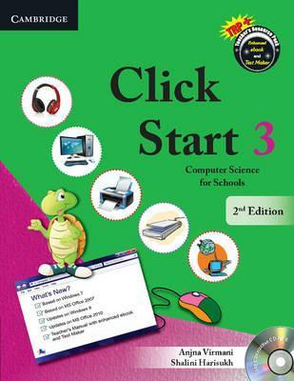
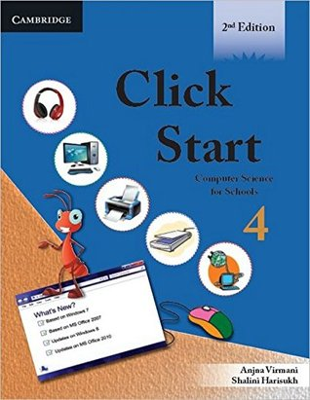

INTRODUCTION
Introduce learners to programming concepts and help them develop their ICT skills.
Books 1 to 5 focus on the fundamentals of computer science. This includes knowledge of software, hardware, networking, MS Office, MSWLOGO.
Time distribution: 2 period/week.

Slide 4
What is the program about?
Computer fundamentals
Key applications
Living online
Computer Science
INTRODUCTION
Notes:
4

Slide 5
INTRODUCTION
This ICT program allows for continuity and progression both within and between the stages.
Stage 1
Computer fundamentals: Basic parts of a computer, Basic understanding of computers.
Stage 5
Computer fundamentals: Input-Process-Output data flow diagram, Network and Internet concepts.
Key applications: Steps to Start Paint, Learn to use some basic tools in Paint, Save a picture in Paint.
Key applications: MS Office at a Glance, Creating Tables in MS Word 2007, MS Word 2007 – Inserting Objects and Drawing, MS Powerpoint 2007 – Editing and Formatting Slides, Introduction to MS Excel 2007, Exploring MS Excel 2007.
Living online: History of the Internet, Governing the Internet, Uses of the Internet, Basic terms related to the Internet, Starting the Internet, Internet Explorer, Netiquette.
Computer Science: Algorithms, Flowcharts, Pseudocode, Simple problems of flowchart and pseudocode.
Notes:
This curriculum covers six main areas called ‘strands’ that work together so that you can teach science holistically:
Biology – living things and how they interact.
Chemistry – the study of matter.
Physics – the interaction of matter and energy.
Earth and Space – planet Earth, the wider Solar System and beyond.
Thinking and Working Scientifically – develops understanding and skills of scientific models and representations, scientific enquiry and practical work.
Science in Context – helps teachers demonstrate the relevance of science to learners and unique to our science curriculum.
5

Slide 6

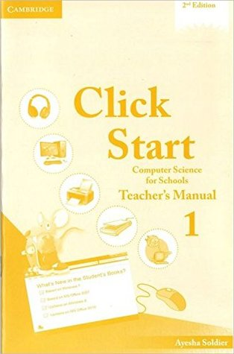
INTRODUCTION
From grade 1 to 5
Resources for teachers

Slide 7
USING RESOURCES
Click start: Computer Science for Schools
Student Book
Snap Recap to reiterate the concepts learnt earlier
Activities interspersed within each chapter to promote application based learning
Teacher’s manual
Answer Key provides answers to Exercises given in the Student Book
Project Ideas promote individual learning as well as teamwork and help students develop an understanding of importance of technology in our lives.
Fact Files to enhance the knowledge of the students
Quick Key and Try This to introduce shortcuts and alternative methodologies
Glossary and Now You Know to aid quick revision of the concepts learnt
Sample Test Papers can be used by teachers for assessment work throughout the year

Slide 8
USING RESOURCES
Teachers should
Preparation
Determine your lesson goals
(base on the syllabus but with input from teachers and students.
Identify the activity and scientific terms in the lesson
Lesson plan
Identify main activities in the lesson
Identify teaching methods and write your teaching process

Slide 9


USING RESOURCES
Students learn both the MOET and Cambridge ICT.
Teachers should carefully read content comparison table.
For the same content, teachers should teach scientific terms and expressions in English.

Slide 10
ASSESSMENT
Types of assessment
Formative: to establish whether learners have met the learning outcome or are on track to do so.
Summative: to 'sum up' what learners have achieved.
Functions
Formative Diagnosis: to identify why learners do not understand or have difficulty with some topic or idea and to use this information to take appropriate action to correct mistakes or misconceptions. Formative Evaluation: to determine whether the action following the diagnosis has resolved the learner’s difficulties.
Summative Evaluation: to establish what general level of ability the learner has attained in terms of understanding, selecting and applying the knowledge and skills they have been taught.

Slide 11
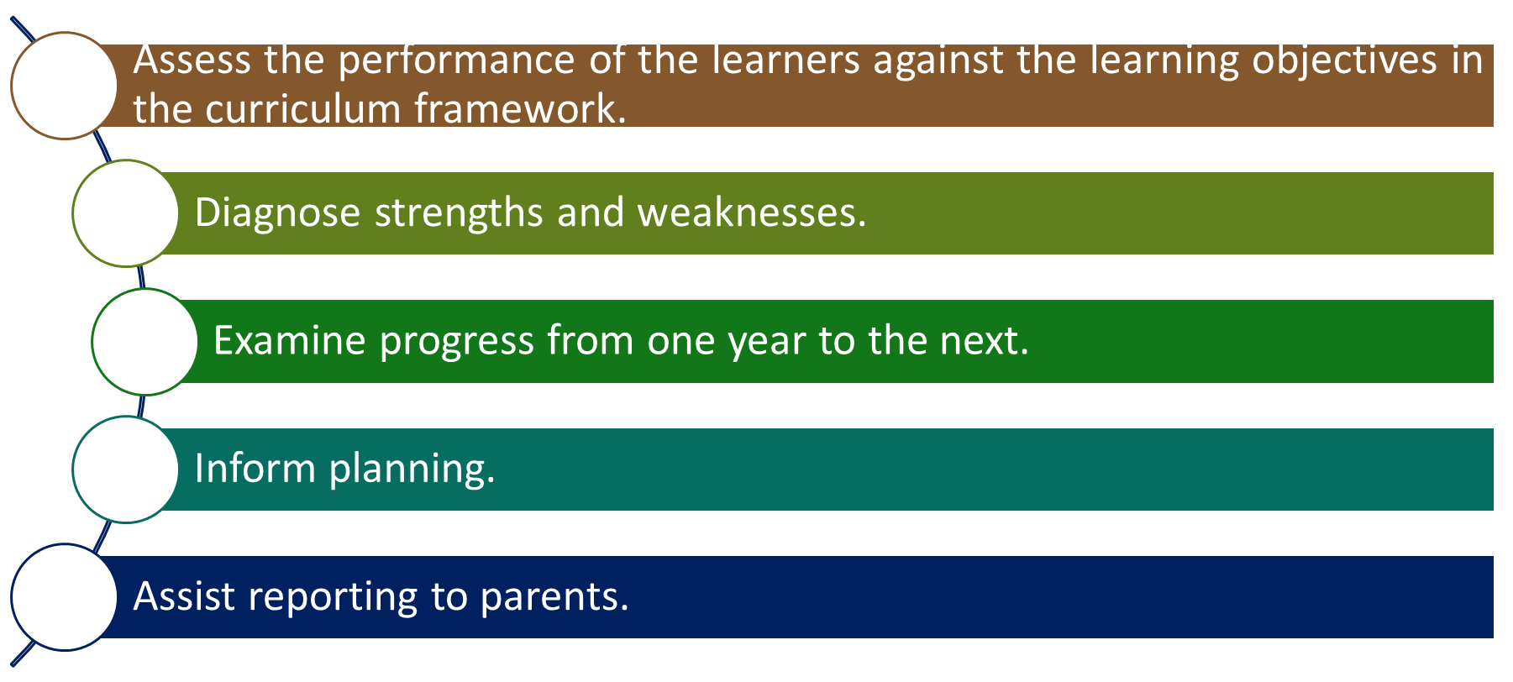
ASSESSMENT
The tests are designed to be flexible and can be used to:

Slide 12
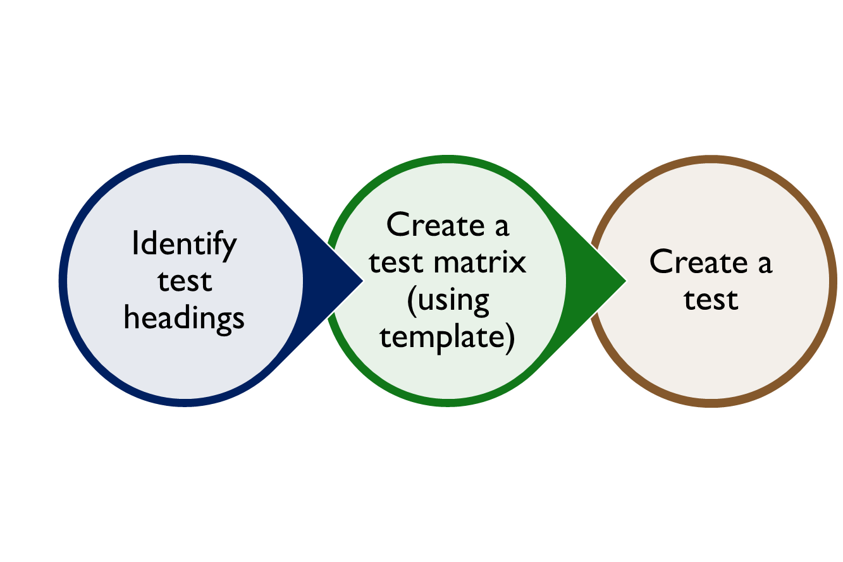
ASSESSMENT
Check out process:
Refer to the illustrative exam questions.

Slide 13
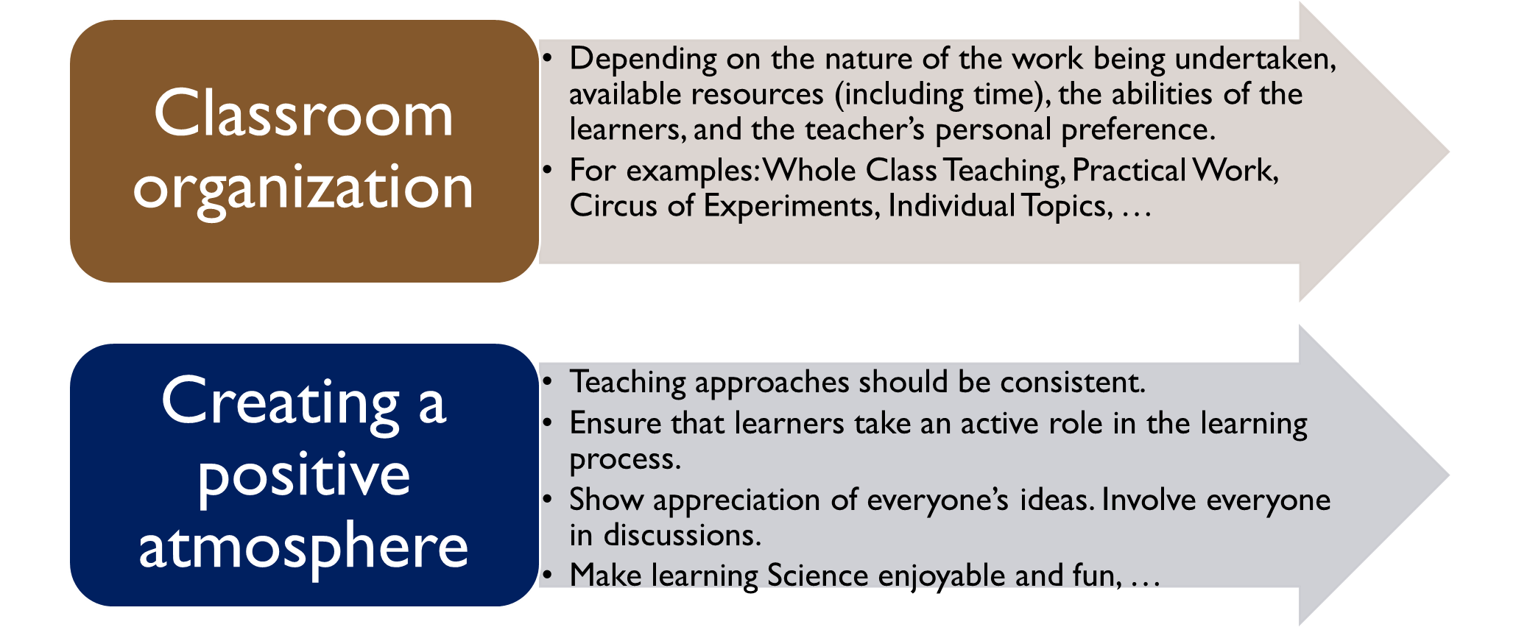
LEARNING ENVIRONMENT
Teachers should create a positive learning environment.

Slide 14
LESSON PROGRESS
Suggest a lesson progress
Engage: Teachers open a lesson with an activity or question meant to engage students.
Step 1
Introduction: Teachers introduce topic, titles of the lesson, repeat science class rules.
Step 2
Practice:
Students carry out hands-on activities.
Students applying what they’ve learned to new situations.
Step 3
Summary: Students summarize and reflect what they’ve learned.
Step 4
Notes:
Thông qua các hoạt động học, học sinh nhận biết được động vật và thực vật trong cuộc sống, phân biệt được chúng với các vật không có sự sống, học sinh học và thực hành được các từ vựng liên quan tới chủ để, , rèn luyện kĩ năng quan sát, thu thập, lưu trữ và phân tích dữ liệu. Kĩ năng chia sẻ thông tin và kĩ năng lắng nghe.

Slide 15
LESSON PROGRESS
ICT activities
Reading book
For example: Students read and describe the functions of Monitor, CPU, Keyboard.
Project
For example: Students create a web page.
Practice
For example: Students create a list of grocery items
Research
For example: Students search information about Microsoft Office.

Slide 16


